Slide 1
CCIBT Hackathon 2025
Team Mercurious
Challenge: System Observability -Volume Spike

Slide 2
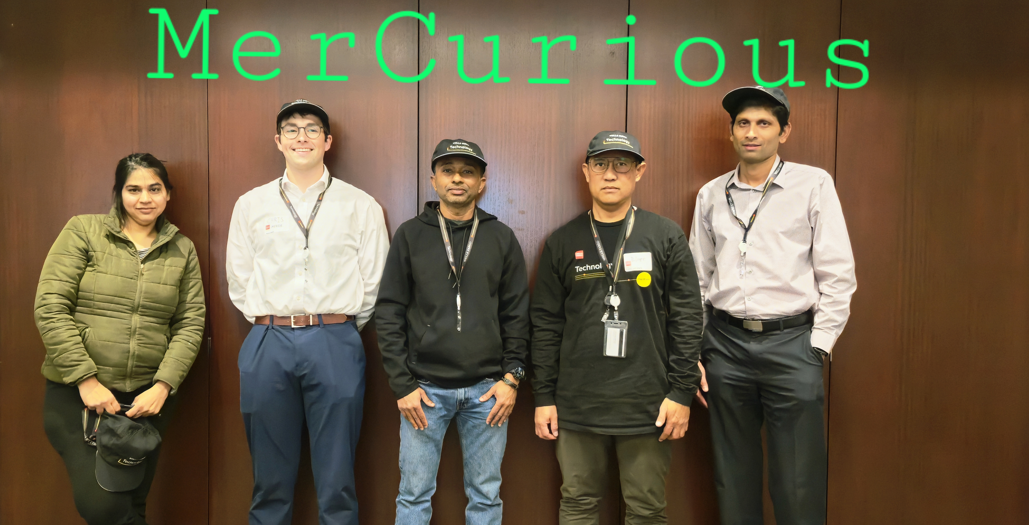
Team Members
Chris Mercer – UI & ADK Agent
Elmer Cabanado – ADK Agent & Model training
Poonam Nagdev - UI and ADK Agent
Mathew Sijo - ADK Agent & Model training
Minesh Christian – Dataset Preprocessing, Model training, ADK Agent & Observability

Slide 3
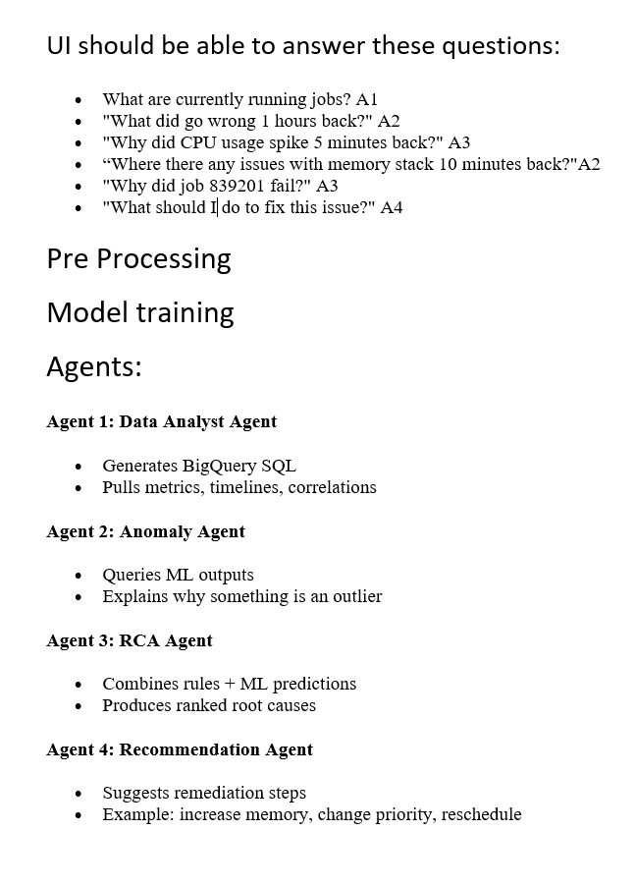
Solution – Process and Planning
Organizations frequently encounter unexpected volume spikes in operational or financial reports.
These anomalies often stem from migration activities or workload shifts, but the lack of correlation and clear explanation leads to:
﻿﻿Delays in root cause analysis.
﻿﻿Inefficient resource allocation.
﻿﻿Increased operational risk and cost.
Current processes do not provide timely insights or actionable recommendations, making it difficult for platform and operations teams to respond effectively.
Brainstorming
AI Assistant [Gemini
ChatGPT]

Slide 4
Process/Flow
Features Extraction
Features Scaling
Google Cloud/BQ Ingestion
BiqQuery Model Training
ADK Agents
AI Assistant [Gemini
ChatGPT]
Response to user
Access to BQ Models

Slide 5


architecture
FAST API Service to
Host Agents
UI
REST CALLs
ML Models
Data Tables

Slide 6

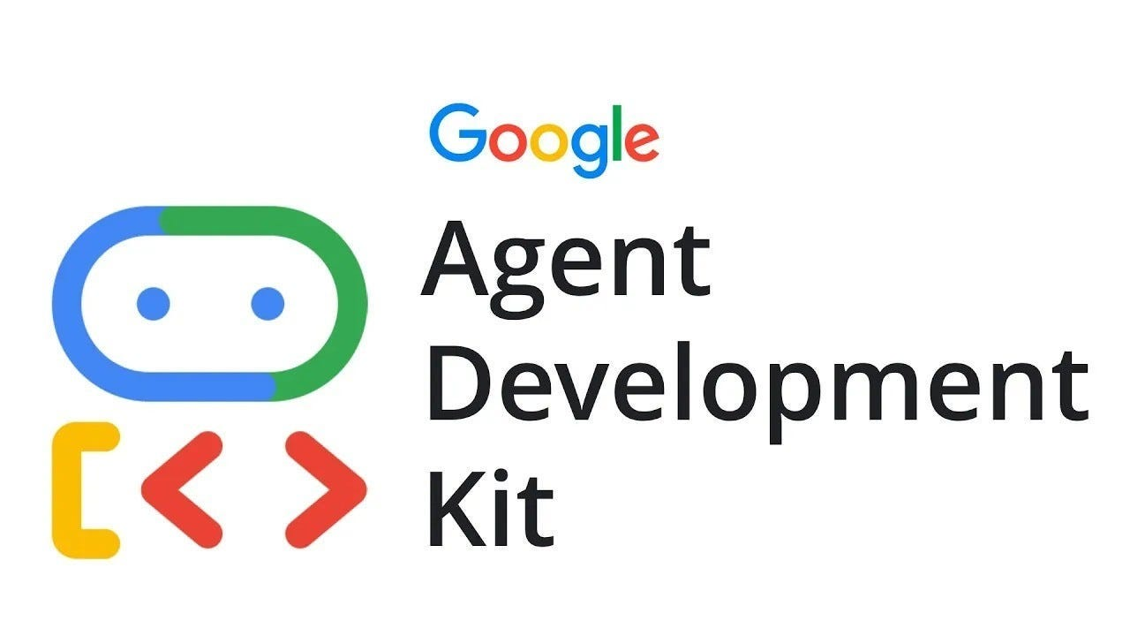



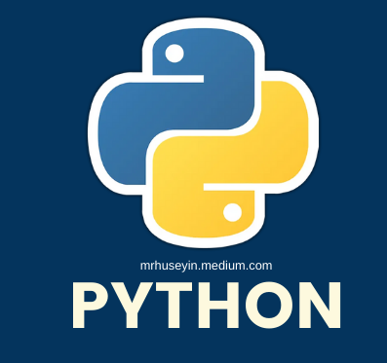
Major components
K–MEANS & PCA for anomaly detection
Contribution Analysis for RCA (Partial work)
ARIMA_PLUS_XREG for time series base forecasting
PROD-Grade Observability
Online Evaluation
Alerts & Custom Metrics

Slide 7
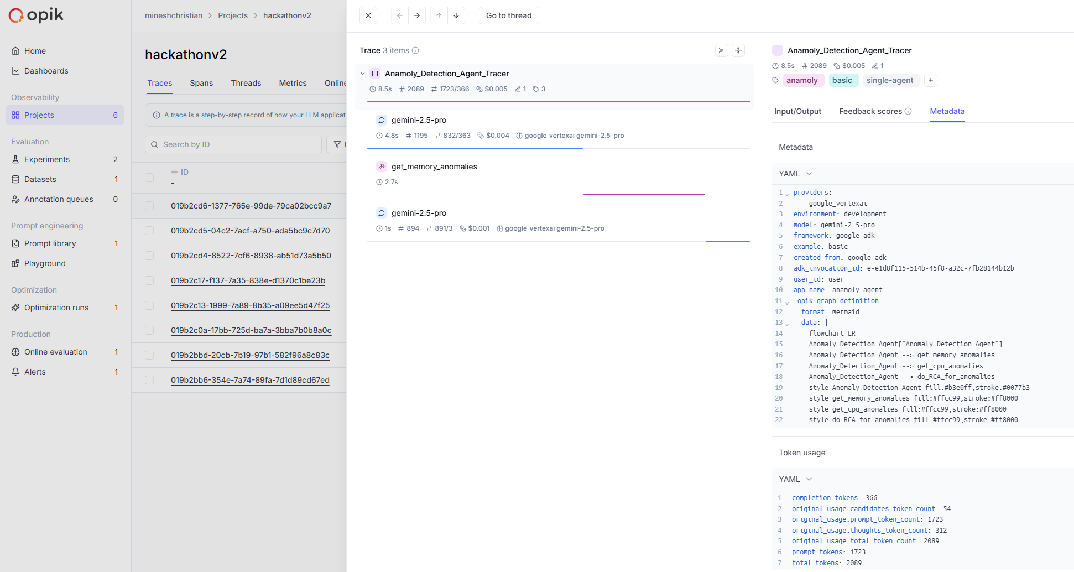
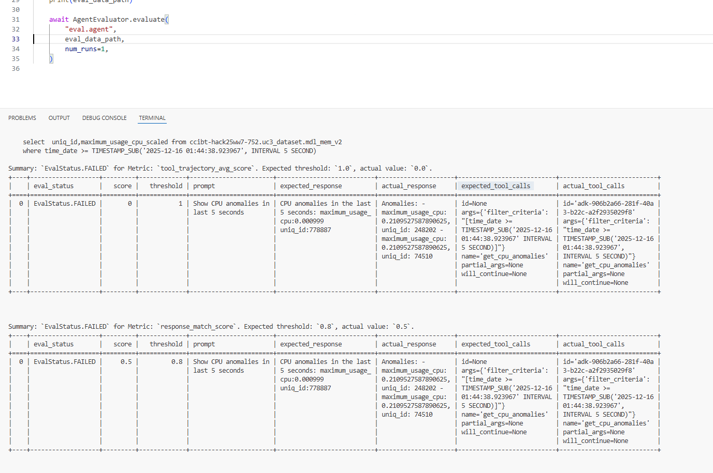
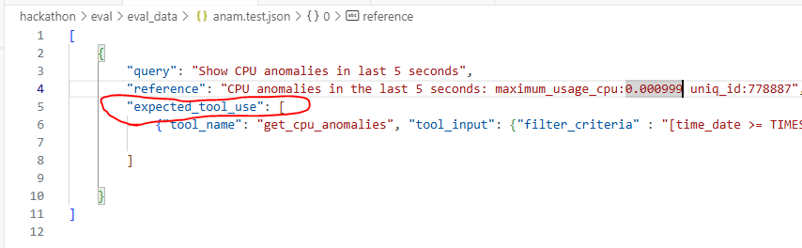
Biggest Risk & Mitigation - Observability
Agent Evaluation using pytest

Slide 8
References
arXiv:2308.12612 Try with Simpler -- An Evaluation of Improved Principal Component Analysis in Log-based Anomaly Detection - PCA
Anomaly Detection using K-Means Algorithm
VISUALIZE NETWORK ANOMALY DETECTION USING K-MEANS
Machine Learning-Enhanced Root Cause Analysis for Rapid Incident Management in High-Complexity Systems | Journal of Science & Technology

